Slide 1
Power BI Pre-Lab
FSI CSU SWARM

Slide 2
Introduction

Slide 3
Abstract and learning objectives
Introduction to the Module

Slide 4
Introduction
Power BI Service Introduction | This PowerPoint will discuss Power BI Service, Compare it with Power BI Desktop, and provide some additional technical information

Slide 5
Power BI Service
Power BI Service

Slide 6
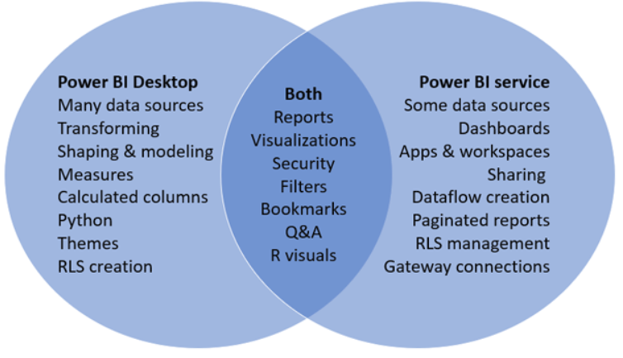
Power BI Desktop vs Power BI Service
The Venn Diagram provides a way to easily compare and contrast the offerings available between the two platforms:

Slide 7
Power BI Service
Provides cloud-based foundation for power BI platform
Accessible with browser through https://app.Powerbi.Com
Accessible through power BI mobile apps
Accessible to developers through power BI service API

Slide 8

Using the Power BI Service API
Accessible by making direct REST calls against service
Accessible by using assembly DLL that abstracts away REST calls
Assembly DLL is named microsoft.Powerbi.Api.Dll
Assembly DLL part of nuget package (microsoft.Powerbi.Api)
Calling service requires authentication with azure active directory

Slide 9
Wrap Up

